Slide 1
Recursion in Python
DVT101 – Lecture 13
- By Dataverse Tutorials

Slide 2
What is Recursion in Python?
Function calling itself
Breaks big problems into small parts
Useful for repetitive patterns
Common in Data Structures & Algorithms

Slide 3
Core Concept of Recursion
Function calls itself
Same logic repeated
Smaller input each time
Stops at base condition

Slide 4
How Recursion Works Internally
Uses call stack
Each call creates stack frame
Stores variables & return address
Stack clears after base case

Slide 5
Structure of Recursive Function
Base Case (Stopping condition)
Recursive Case (Self call)
Modified parameters
Guaranteed termination

Slide 6
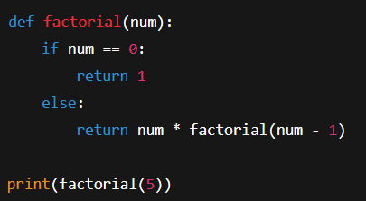
Recursion Example: Factorial
Mathematical problem
n! = n × (n−1)!
Base case at n = 0
Classic recursion example

Slide 7
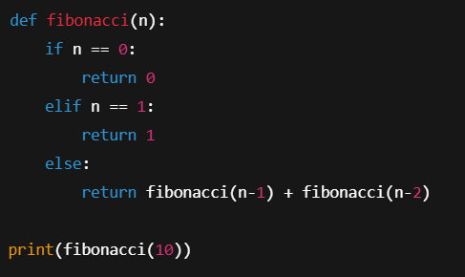
Example 2: Fibonacci Sequence
Two recursive calls
Base cases at 0 and 1
Expensive recursion
Demonstrates inefficiency

Slide 8
Types of Recursion
Tail Recursion
Non-Tail Recursion
Difference in execution
Optimization concept

Slide 9
Recursion vs Iteration
Recursion = stack based
Iteration = loop based
Recursion = readable
Iteration = efficient

Slide 10
When to Avoid Recursion
Large input size
Deep recursion
Performance critical code
Risk of stack overflow

Slide 11
Summary & Key Takeaways
Recursion = self calling function
Base case is mandatory
Uses call stack
Powerful but risky

Slide 12


